Slide 1
Intro to Web APIs and Postman
Tanya Do
Lunch and Learn
Oct. 13, 2016

Slide 2
Agenda
What are web APIs?
REST
.NET’s Web API Framework
Postman
Demo
Q & A

Slide 3
What are Web APIs?

Slide 4
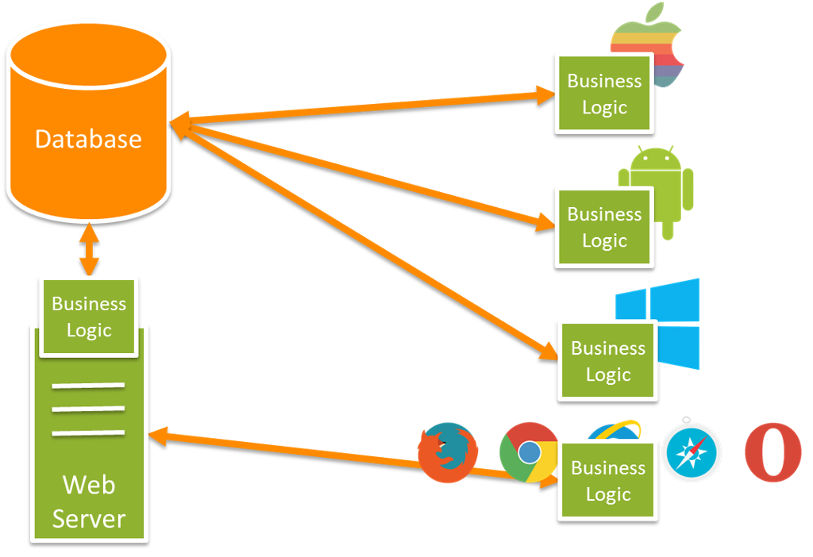

Slide 5
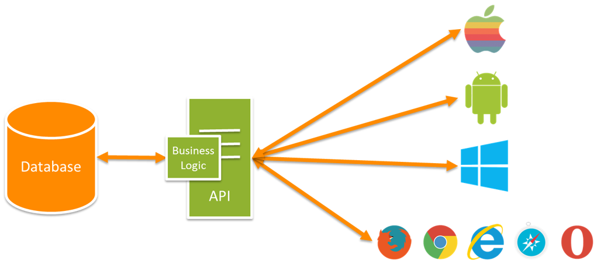
Notes:
Add another API

Slide 6
REST

Slide 7

REST is my favorite…

Slide 8
Why talk about REST?
Pretty much all APIs are Restful APIs
Architectural design pattern
REST = REpresentational State Transfer
Stateless (no sessions, )
Representational (instead of object = light weight)
Built based on HTTP (requests, response, verbs, status codes to comm.)
CRUD verbs (GET, POST, PUT, DELETE)
Resources vs Service
Accessing name resources (via URIs) : VERB-NOUN
GET http://example.com/path/to/resource

Slide 9
Benefits of REST
Nearly all clients understands HTTP - Simple and Unambiguous
Supports different formats (JSON, XML)
Light weight
Scalable
Cache-able

Slide 10

Fun Fact
Created by Roy Fielding in 2000
‘Architectural Styles and the Design of Network-based Software Architectures’
And he has a twitter account: @fielding
This is him:

Slide 11
ASP.NET’s Web API Framework

Slide 12
Web API Framework
Does heavy lifting for you
Works seamlessly with Entity Framework and MSSQL
Auto Serialization to JSON or XML
Scaffolding
Dynamic Help Pages
Routing
Default convention: http://example.com/api/{controller_name}/{id}
Or customize with route attributes

Slide 13
Postman

Slide 14


Slide 15


Slide 16
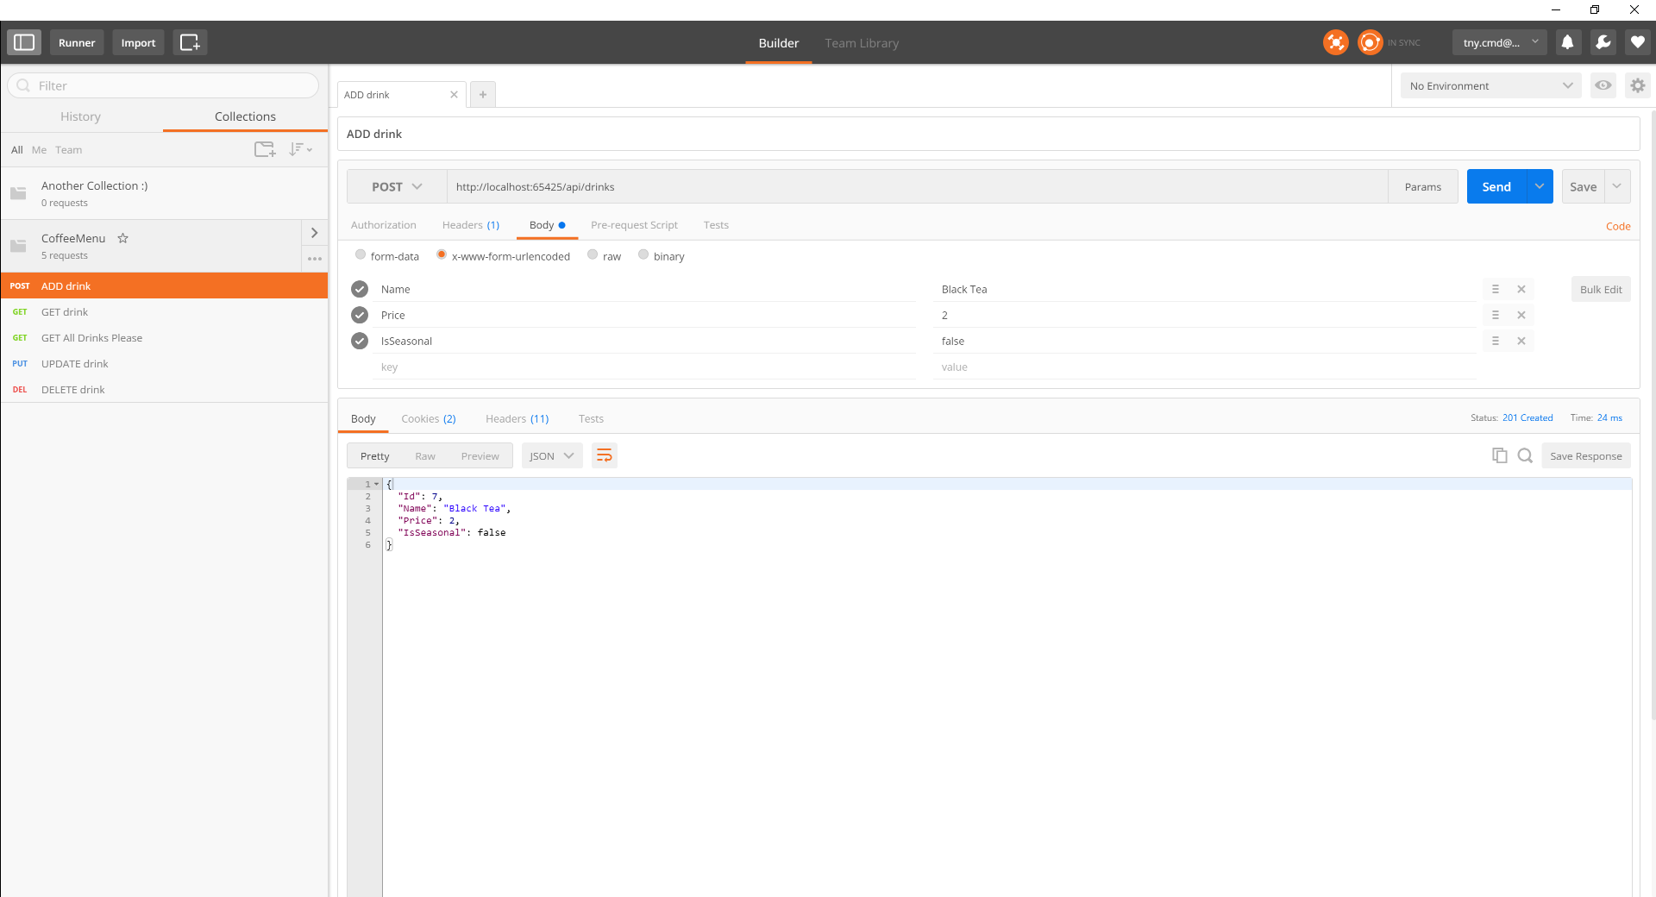

Postman is a tool

Slide 17
Let’s Build an API
Demo

Slide 18
Questions?

